Slide 1

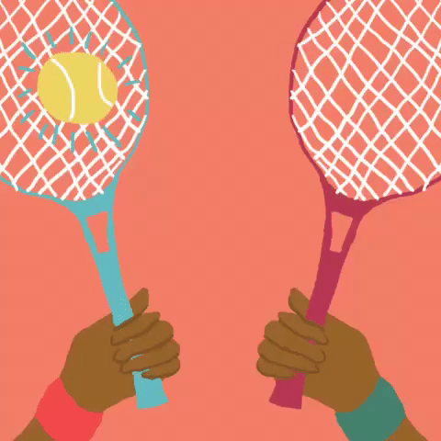
Fantasy Tennis App
Kaycee, Steph, Fred, Sam, Greg

Slide 2


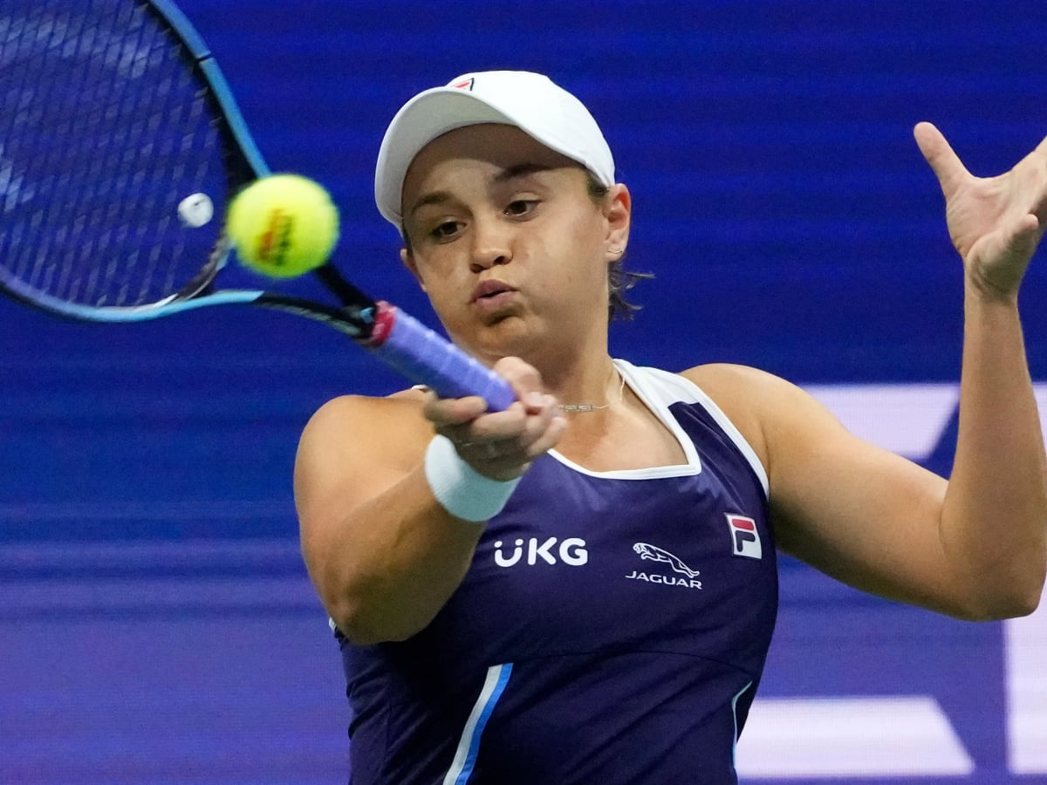
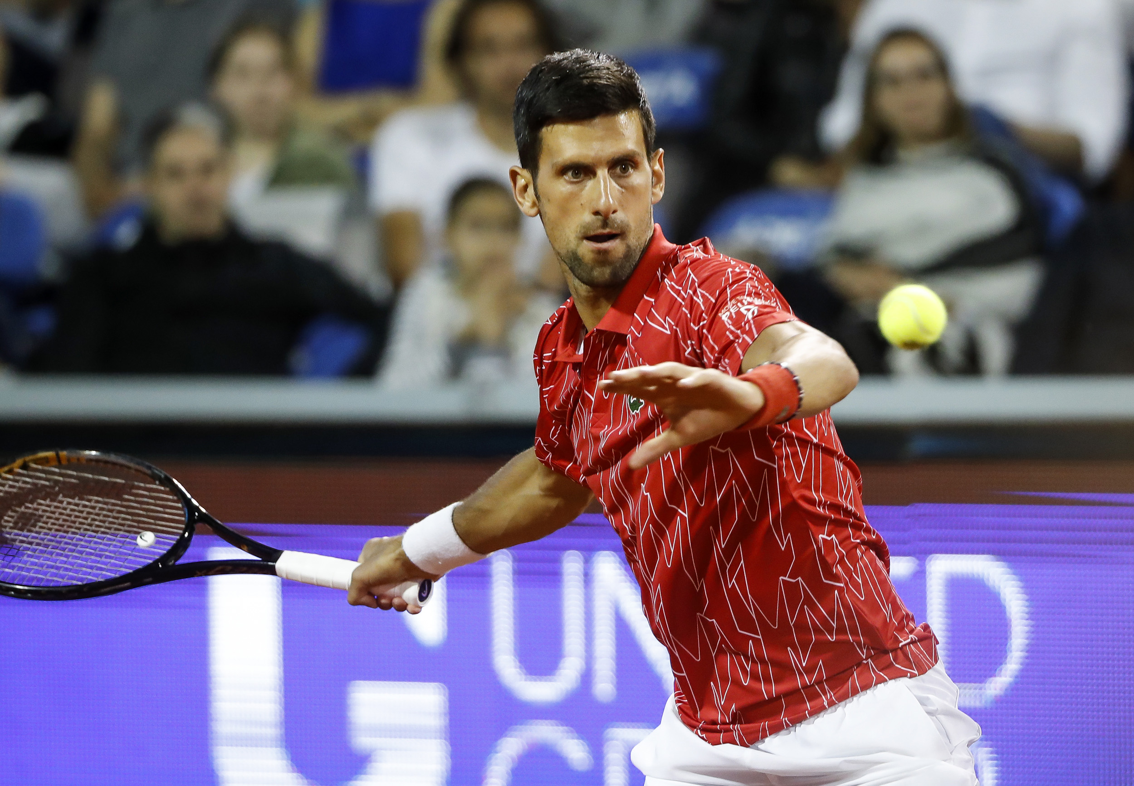
Introduction
Developers creating a Fantasy Team App for Tennis
Consideration for which factors need to be weighed
Wide scale factors
Player performance

Slide 3
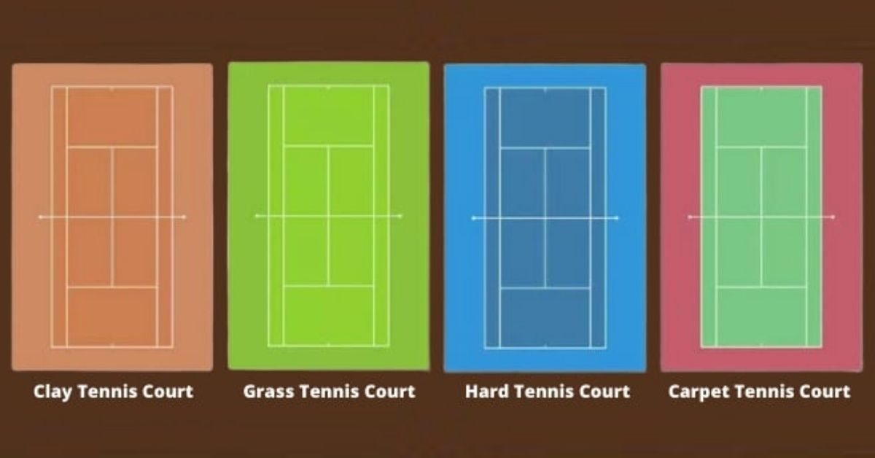
Court Surface
Hypothesis #1: USA and more Asian and European countries would appear in top 20 when looking at hard surface wins
Hypothesis #2: More Latin American countries would appear in top 20 when looking at clay surface wins
Surface is expected to make a difference due to factors such as different training practices for each region or country

Slide 4
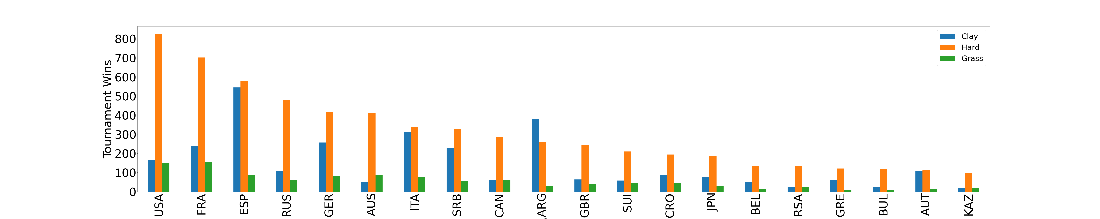






Top 20 countries by wins on hard surface (2017-2021)

Slide 5
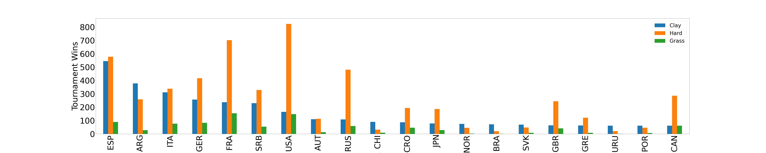

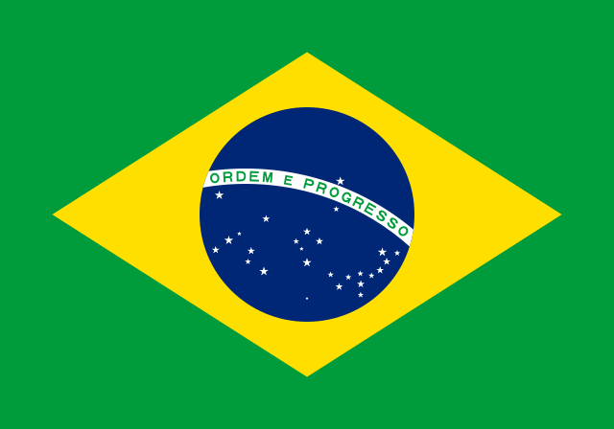



Top 20 countries by wins on clay Surface (2017-2021)

Slide 6
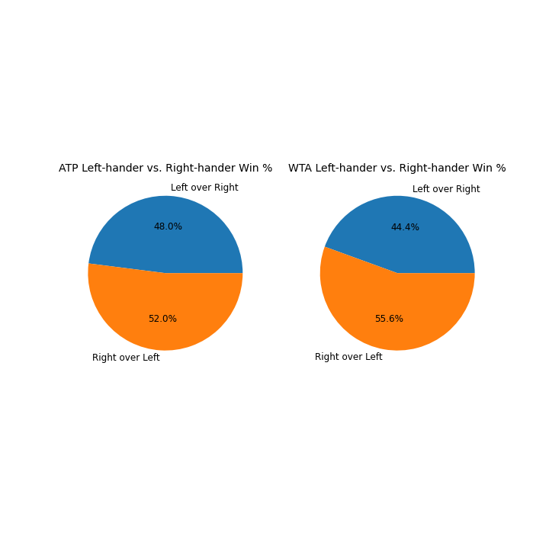
Left and Right hand win rates
Hypothesis: Left handed has an advantage over right
Overall, right wins over left
However:
Male left handers have 53% win rate over male right handers on clay courts
Females show no preference for surface and a preference for right overall
Nadal is an outlier (18% of the total left hander wins on clay courts) in dataset
Further research is necessary
Notes:
Throw it to Sam and say “this may be due to player patterns”

Slide 7
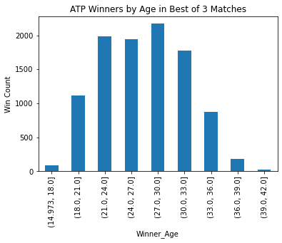
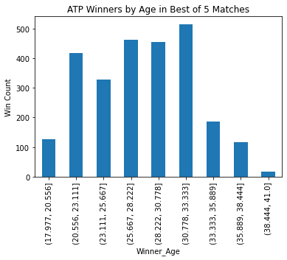
ATP Winners age BO3 & bo5
Notes:
Sam will briefly discuss player patterns and muscle memory; then lead into age

Slide 8
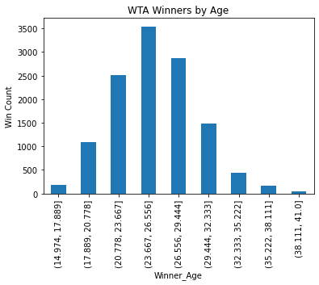
WTA winners Age
Biology: women mature earlier
Play Style:
Women play flatter, more power-focused tennis
Men play with more top-spin, have longer rallies, and more stamina-focused
Future research ideas:
Height
Weight

Slide 9
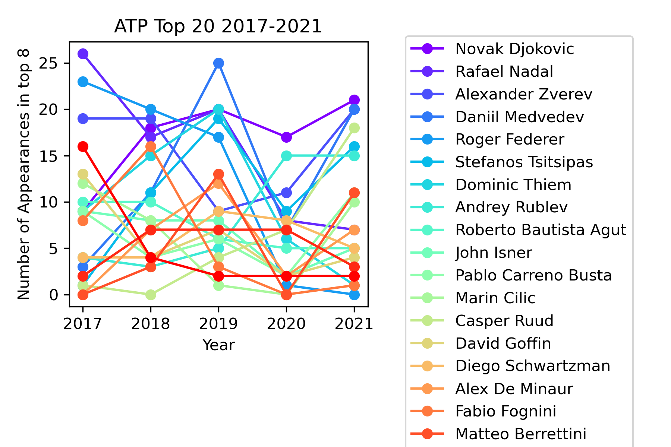
ATP Top 20 players
Top heavy due to particularly talented generation
COVID limited number of tournaments in 2020 and 2021
Variance = 376
Median = 32
Future research:
Weather and infrastructure
Injuries and type of injuries
Other reasons for variance (mental health, burn out, personal reasons, etc.)
Notes:
Talk about rainbow cm library

Slide 10
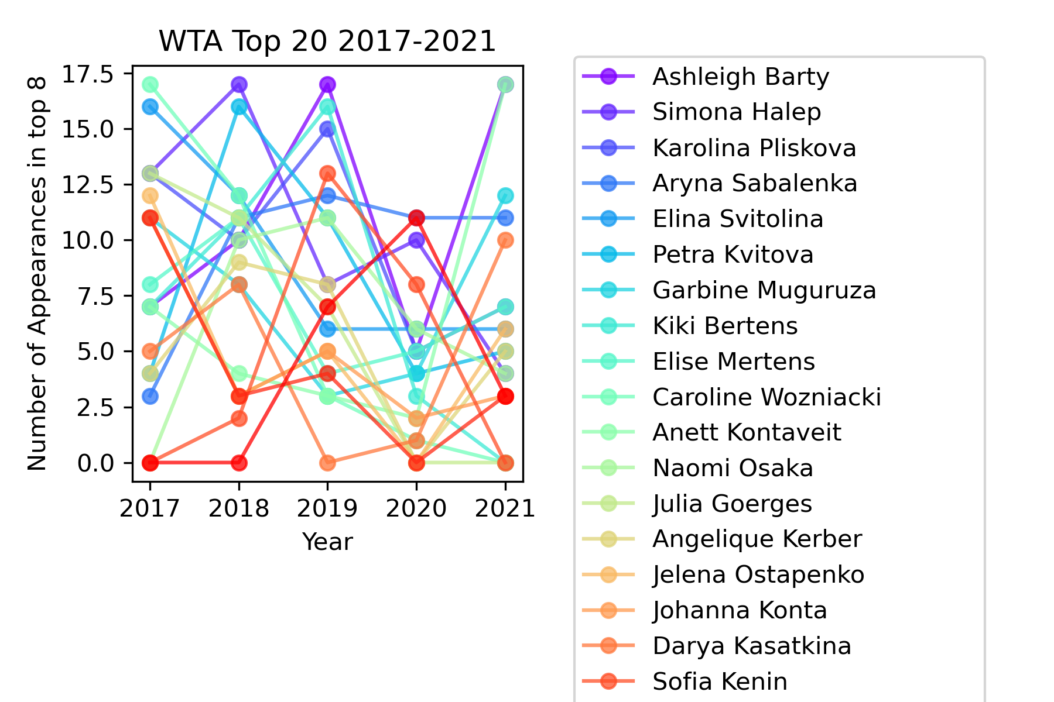
WTA Top 20 Players
Top 2, but overall less variance than ATP
Variance = 113
Median = 33
Future research:
Weather and infrastructure
Injuries and type of injuries
Other reasons for variance (pregnancies, mental health, burn out, personal reasons, less likely to receive help from tennis organization, etc.)

Slide 11
Conclusions
Nationality indicates preference, but further research is needed to indicate performance
Handedness alone does not seem to be a big factor, but it might situationally
Age is impacted by biology and play style
Overall, the sport is top heavy, but females show much less variance
Prize pool distribution is top focused, which effects access to resources
Other factors need to be examined
Mental health needs to be measured in some capacity because sport is based on individual performance vs team performance

